Slide 1
BlueShadow Maritime Domain Awareness and Response (MDAR)
www.blueshadow.dk charles.maher@blueshadow.dk
+45 2212 6603

Slide 2
Securing the Maritime Domain in the Era of Hybrid Warfare​
Illuminate the hidden​
Flag emerging threats​
Protect critical assets before adversaries strike

Slide 3
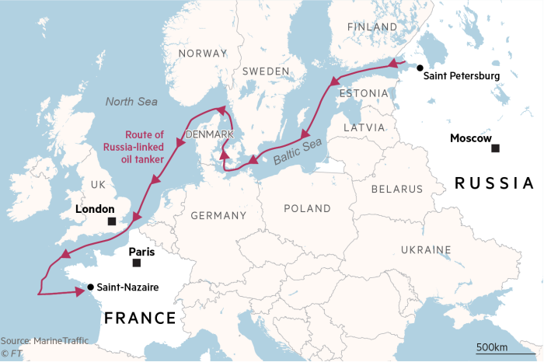
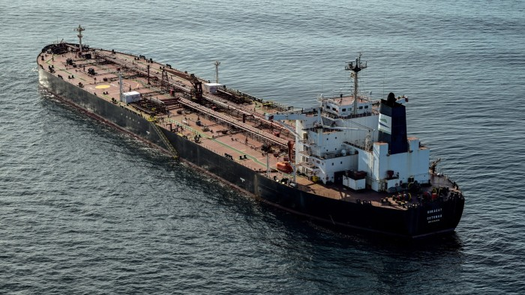
Problem
Hybrid Warfare is on the rise
Cut communication and power cables
Ruptured gas pipelines & pollution
Shadow fleets as surveillance platforms
Illegal fishing by foreign fleets
Growing impacts to trade, communications, energy, public safety, and national security
EU governments and companies are unprepared for the new era of hybrid warfare
Source: Financial Times
Source: Damien Meyer/AFP/Getty Images
Sep 2025: Russian ‘shadow’ tanker Boracay detained by France for failing to prove its flag registry. Boracay passed near Denmark when drone activity disrupted air traffic and exposed weakness in defense of Danish military bases.

Slide 4
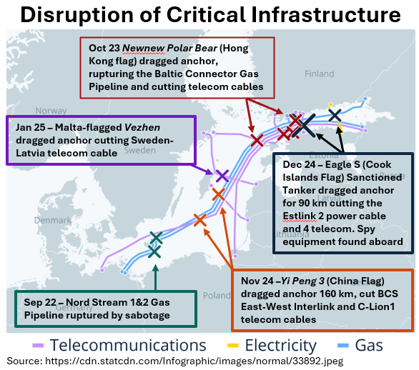
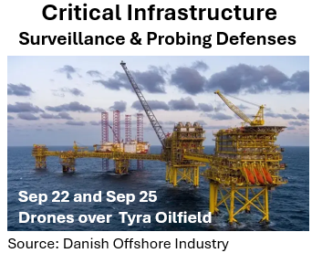
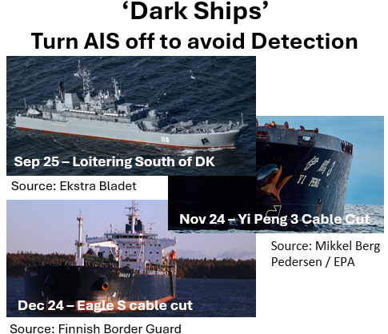
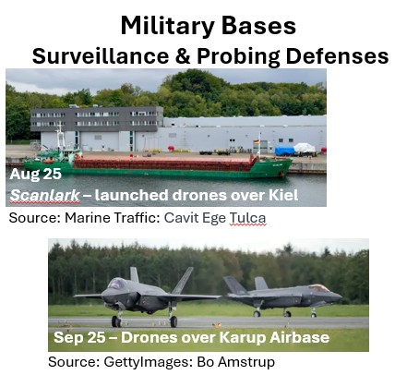
Why Now
Increasing Russian aggression toward Western Europe
Georgia (2008), Crimea (2014), Ukraine (2022-present)
Ramp-up in Hybrid Warfare in the Baltic
Uncertainty of American Security Commitment
NATO and EU unprepared and looking for solutions

Slide 5
Solution
Blue Shadow MDAR is a dual-use, subscription-based maritime security SaaS solution that delivers a multi-tier service, including:
Tier 1: High-Confidence Maritime Common Operating Picture – real-time interactive displays of maritime activity, including ‘dark ships’, verified by cross-correlation of multi-source data
Tier 2: Enhanced Operating Picture around Critical Infrastructure– tailored sensor packages fused with historical and real-time data focused on critical infrastructure
Tier 3: AI-Powered Predictive Alerts – advanced algorithms providing early warning of threats to critical infrastructure
Tier 4: Rapid Security Response – deployment of autonomous or manned assets to deter, interdict, and record evidence of threats/attacks on client assets

Slide 6
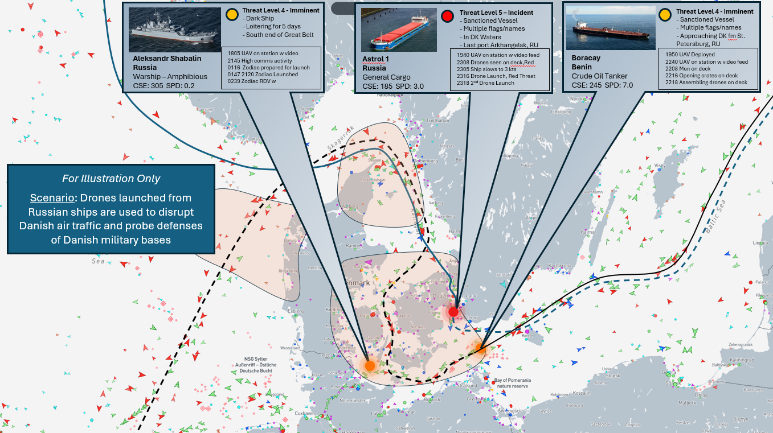
BlueShadow Interface Mock-up
Tier 1: Common Operating Picture (COP) AI-driven multi-sensor analysis creates verified Common Operating Picture (COP) for all vessels
“Dark Ships” and ships spoofing AIS are identified and located
Click on contact to display full vessel profile
Click to show track History & Forecast
Tier 3: Security Alert
AI-generated security alert based on multi-factor analysis
Threat vessel pop-up keeps key info always on top
Tier 4: Operational Security Response
Security platform(s) (UAV, USV, etc.) deployed to interdict, deter and record before incident occurs
Team chat facilitates coordination to align on observations, decisions and actions
Live UAV video feeds available to all team members
Event recorded with full play-back; supports investigations and legal proceedings
Tier 2: Enhanced Operating Picture (EOP)
Tailored sensor packages deployed to monitor Critical Infrastructure
Sensor data fused with COP to enable hyper-awareness of potential threat activity in critical protection zones
Background Graphic: Marine Traffic

Slide 7
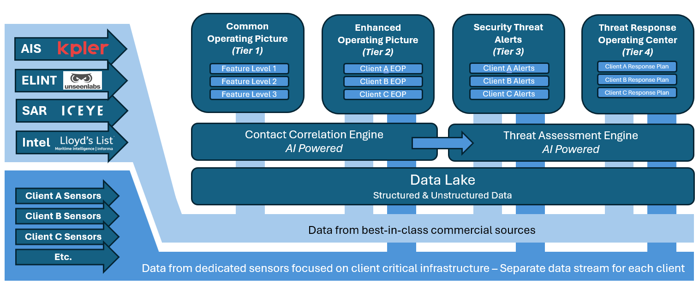
BlueShadow Tech Platform
BlueShadow
Service Tiers
BlueShadow
Cloud Architecture
& Compute
(Proprietary IP)
BlueShadow
Data Streams
(Strategic Partners)
Key Terms: AIS = Automatic Identification System ELINT = Electronic Intelligence SAR = Synthetic Aperture Radar

Slide 8
Product Roadmap
BlueShadow Founded
Jul 2025
BlueShadow User Interface
Nov 2025
BlueShadow MVP Launch
Mar 2026
BlueShadow
Ver 1.0 Launch
Jan 2027
BlueShadow
Ver 2.0 Launch
July 2028
Interactive user interface to visualize and demonstrate features
Capability demo tool
User experience feedback
Baltic/North Sea Coverage
Full-stack cloud-deployed
Fed by 4 data streams: AIS, ESM, SAR, Ship Intel
Agentic AI model built
Real-world use with 3+ anchor customers
Co-develop product enhancements and AI Model improvement
Baltic/North Sea Coverage
At-scale commercial operations
Worldwide coverage
BlueShadow Ops Center
Dedicated sensors (Tier 3) launched with sensor partner(s)
Response capability (Tier 4) launched with security partner(s)
Enhancements based on experience & feedback
Offer containerized deployment of BlueShadow in classified environments
Deploy proprietary sensor network (space, air, surface, undersea) to enhance collection capability and resilience

Slide 9
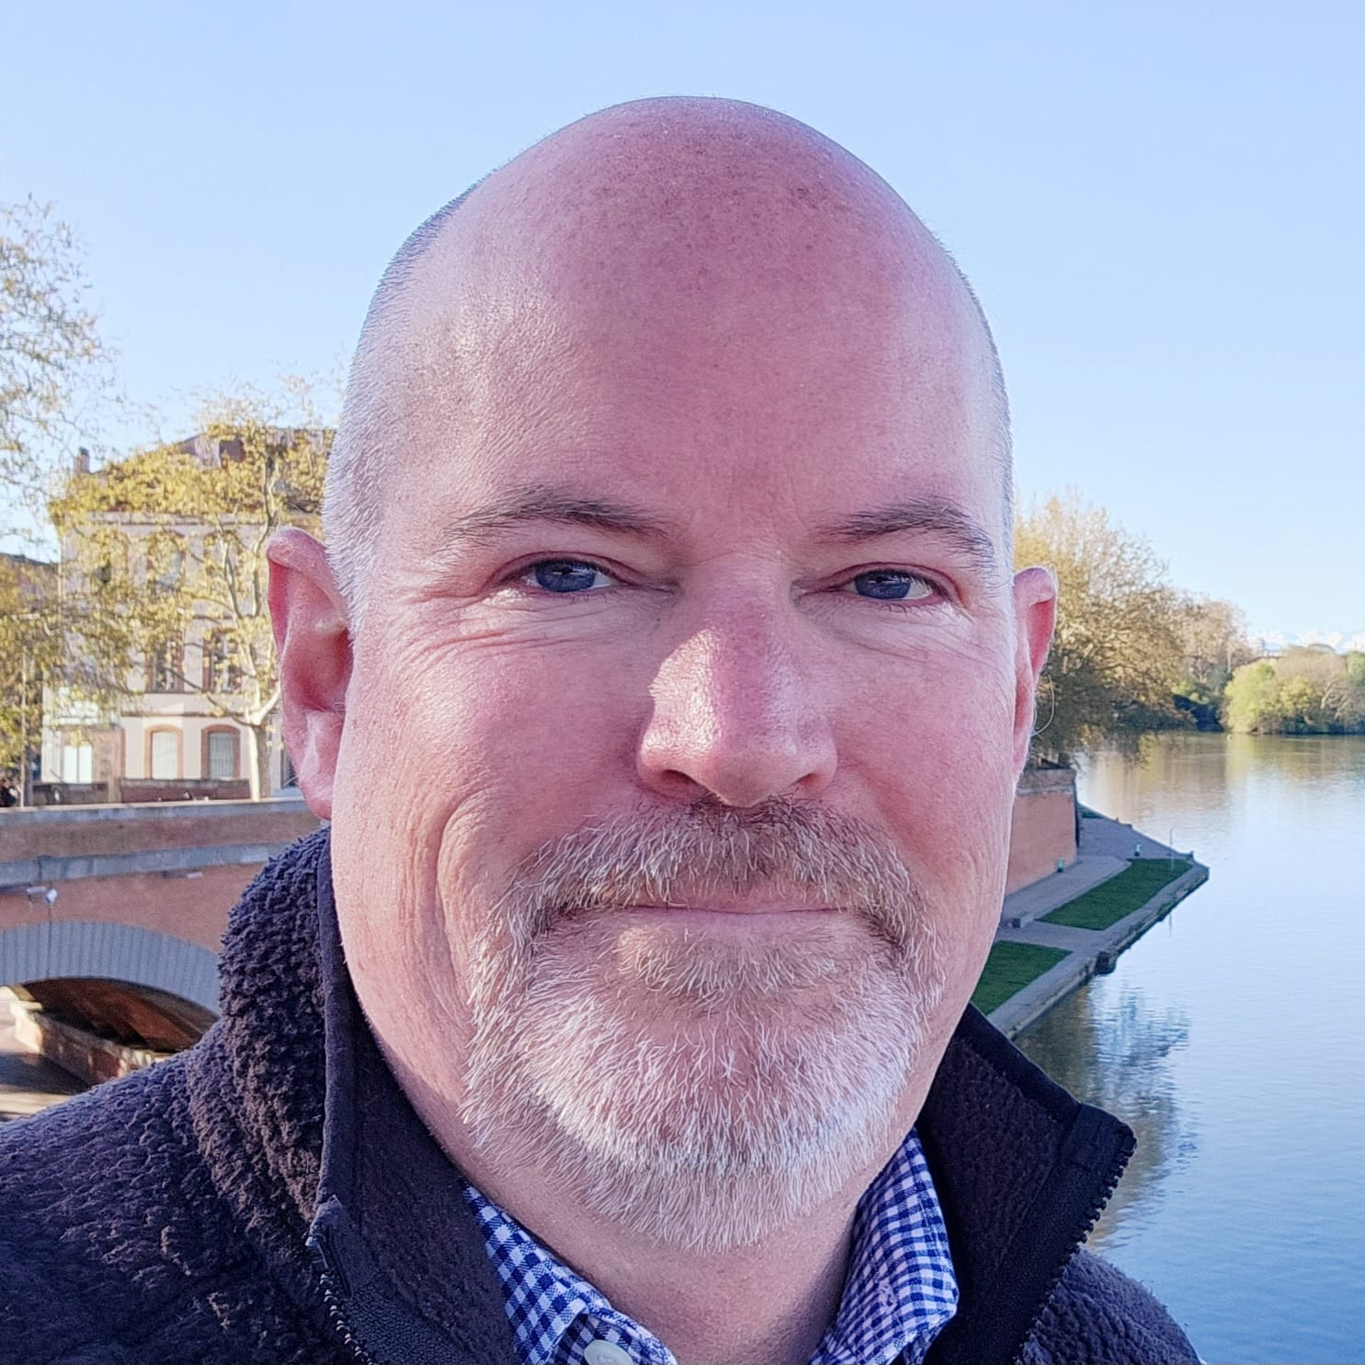
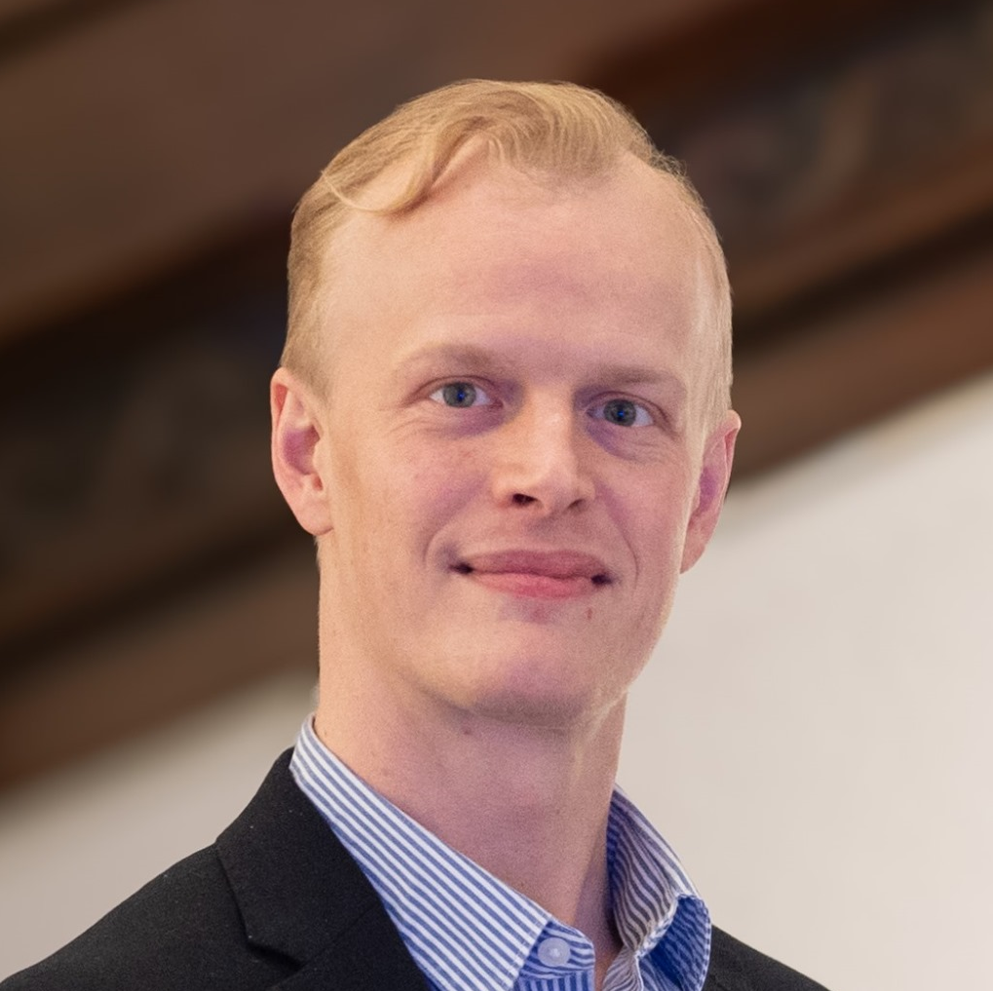
Team
Charlie Maher, U.S. citizen is the Owner & Founder of BlueShadow ApS.
Charlie served in the submarine force of the United States Navy where he commanded a nuclear-powered submarine and was the Chief of Staff of the Naval Undersea Warfare Center, the Navy’s R&D facility for undersea weapon systems.
Charlie holds an MBA from Massachusetts Institute of Technology and lives in Copenhagen.
Emil C. Lüth, Danish citizen, leads Strategic Partnerships & Investor Relations for BlueShadow.
Emil is a climate tech strategist with expertise in finance and international strategy.
He serves in Business Development & Investor Relations at www.tfn-climate.com and Advisory Board Member at www.energyshift.capital and a Fundraising Consultant for www.hykin.energy.

Slide 10
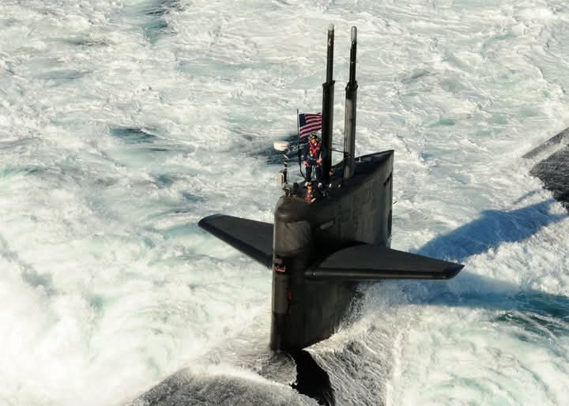
Securing the Maritime Domain in the Era of Hybrid Warfare​
Illuminate the hidden​
Flag emerging threats​
Protect critical assets before adversaries strike
www.blueshadow.dk charles.maher@blueshadow.dk
+45 2212 6603
CDR Charles H. Maher, USN
Commanding Officer, USS MEMPHIS (SSN 691)

