Slide 1
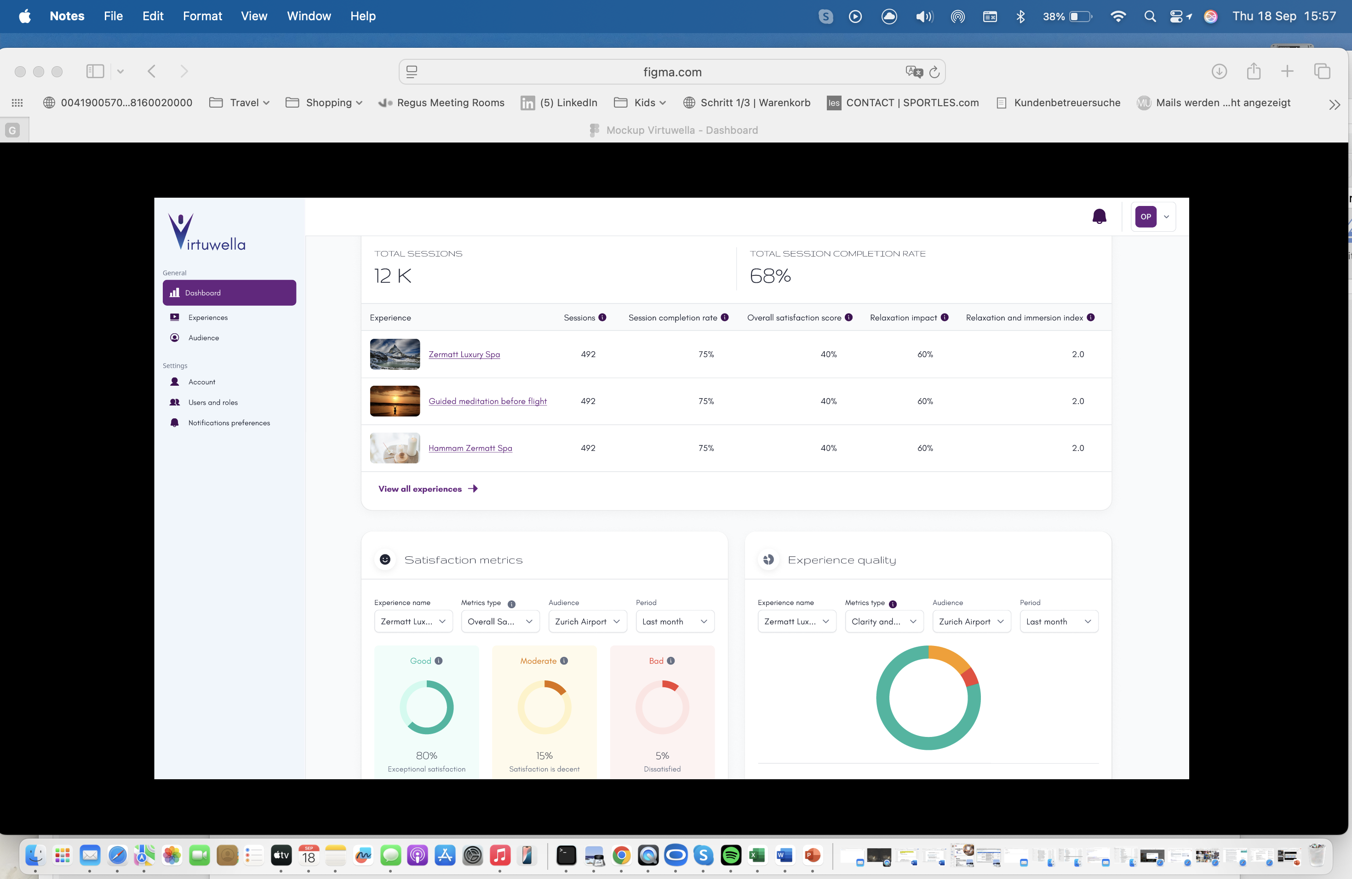
Example Dashboard Virtuwella

